Slide 1
Hobby Web Application
Project
By Mohamed Sajath Mohamed Raffeek

Slide 2
Introduction
Who am I?
How did I approach the specification?

Slide 3
Consultant Journey
What technologies did I learn for this project?
Version Control System: Git
Source Code Management: GItHub
PM Board: Jira
Database Management System: MySQL
BackEnd Programming Language: Java
Build Tool: Maven
Unit Testing: JUnit, Mockito
New Technologies
API DEvelopment Platform: Spring
Fron End Technologies: HTML, CSS, JAvaScript
Static Analysis: SonarQube
User-Acceptance Testing : Selenium

Slide 4
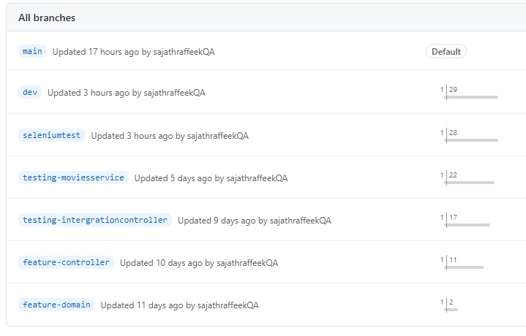
Version Control
How did approach Version Control?

Slide 5
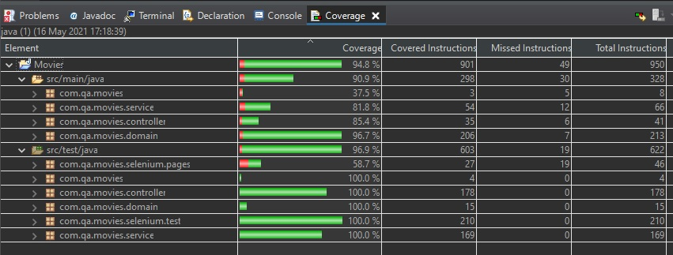
Testing

Slide 6
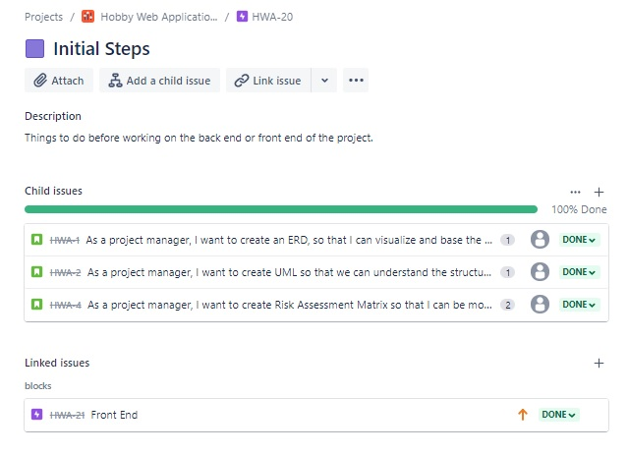
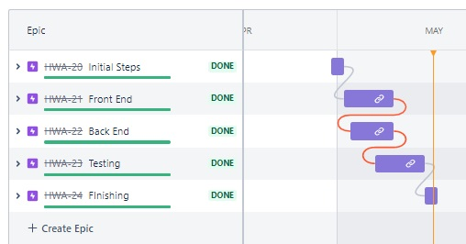
Demonstration
User Stories

Slide 7
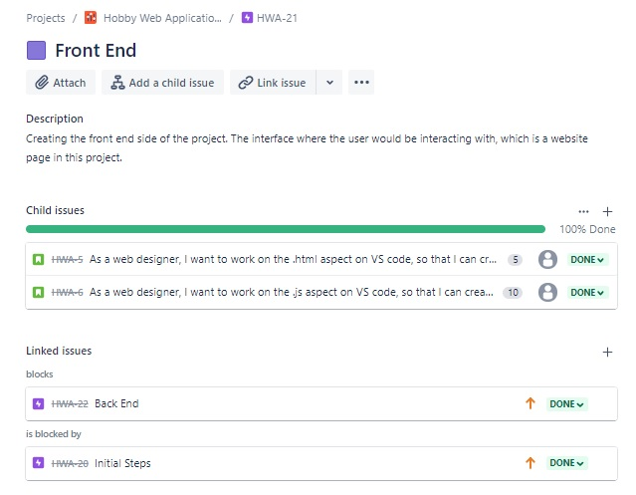
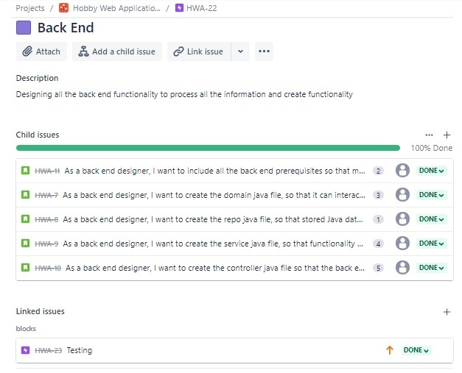

Slide 8
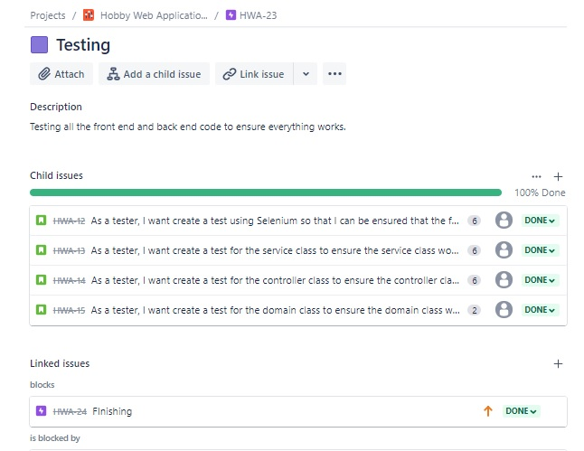
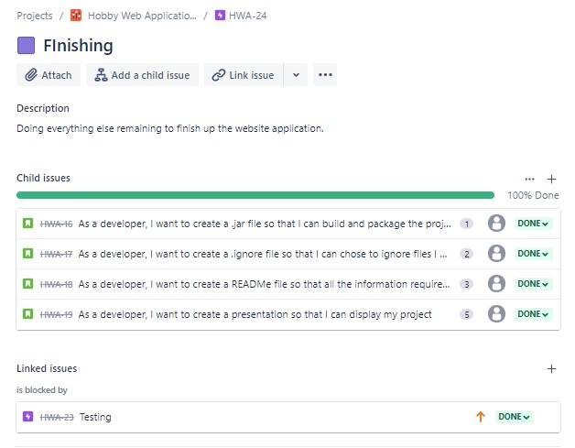

Slide 9
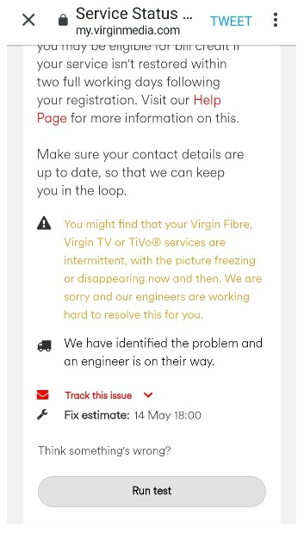
Problems

Slide 10
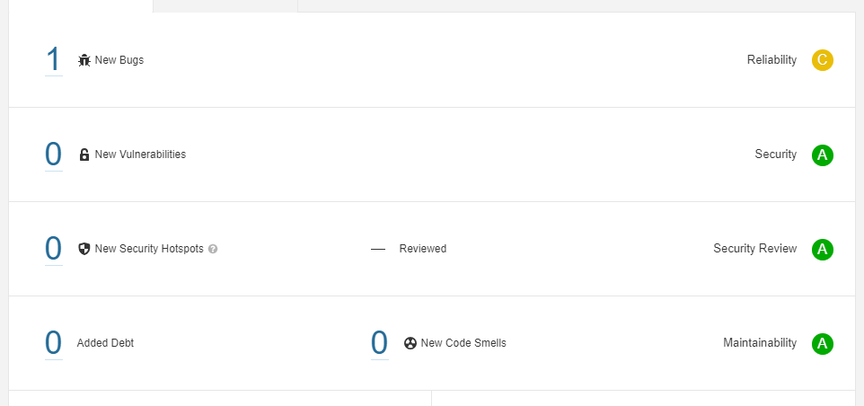
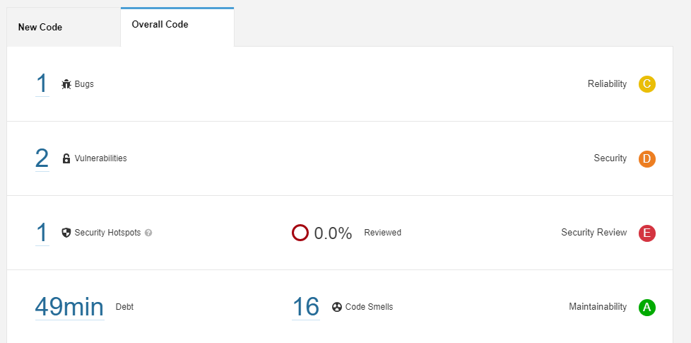
SonarQube

Slide 11
Sprint Review
What did I complete?
What got left behind?

Slide 12
Sprint Retrospective
What went well?
What could be improved?

Slide 13
Conclusion
Reflection on this project, future steps, etc
Any questions?

